Slide 1
Vitamin D Update Smart Life Forum, Oct. 19, 2017
William B. Grant, Ph.D.
Sunlight, Nutrition and Health Research Center (www.sunarc.org)
San Francisco

Slide 2
Disclosure
I receive funding from Bio-Tech Pharmacal, a supplier of research grade vitamin D for health professionals and consumers at
http://www.biotechpharmacal.com/

Slide 3
Outline
Vitamin D physiology
Vitamin D recommendations
Major health outcomes related to vitamin D
Where is vitamin D policy headed?
How to conduct vitamin D clinical trials
For more information, see

Slide 4
Vitamin D Physiology
Vitamin D₃ (cholecalciferol) can be made in the skin or obtained from food or supplements
The liver converts vitamin D₃ to 25-hydroxyvitamin D₃ [25(OH)D₃] by adding an OH. The half life is about 2.5 weeks.
The kidney converts 25(OH)D₃ to 1,25(OH)₂D₃

Slide 5
Serum Calcium Regulation
1,25(OH)₂D₃ and parathyroid hormone (PTH) keep serum calcium within a tight range.
1,25(OH)₂D₃ increases calcium absorption from the intestines
PTH increases calcium absorption from the bones

Slide 6
Other Actions of Vitamin D
Most of the action of vitamin D is through 1,25(OH)₂D₃ entering vitamin D receptors m(VDRs), which are coupled to chromosomes in nearly all cells of the body.
When activated, the VDRs control the expression of many genes, upregulating some, downregulating others.
Many organs can convert 25(OH)D₃ to 1,25(OH)₂D₃ as needed.

Slide 7
More Actions of Vitamin D
Vitamin D fights bacterial and some viral infections by inducing production of cathelicidin, a polypeptide with antimicrobial and antiendotoxin properties.
Vitamin D reduces inflammation by reducing production of proinflammatory cytokines (chemical messengers).

Slide 8
Skin Pigmentation
Skin pigmentation varies globally depending on where people live for hundreds to thousands of years.
Dark skin in the tropics reduces risk of free radical formation and skin cancer as well as folate destruction.
Pale skin at high latitudes permits vitamin D production for low UVB doses.

Slide 9
Human Skin Color Distribution
George Chaplin and Nina Jablonski

Slide 10
Recommendations
Institute of Medicine (Ross, 2011)
600 IU/d to 70 yrs, 800 IU/d >70 yrs
20 ng/mL vitamin D
Endocrine Society (Holick, 2011)
1000-2000+ IU/d vitamin D₂ or D₃
30 ng/mL
Vitamin D advocacy organizations (2015)
2000-5000 IU/d vitamin D₃
40-60 ng/mL

Slide 11
Leaders of the Two Camps

Slide 12
Vitamin D from UVB Exposure
Engelsen O. The relationship between ultraviolet radiation
exposure and vitamin D status. Nutrients. 2010 May;2(5):482-95.

Slide 15
Other Effects of UV Exposure
Production of beta-endorphins by UVB, resulting in desire to get more UVB.
Release of nitric oxide from subcutaneous nitrogen compounds, leading to lower blood pressure.
Reduced risk of multiple sclerosis, in addition to vitamin D.

Slide 16
Those Most Likely to Have Low 25(OH)D Concentrations
Those spending most time indoors.
Not being in sun near solar noon with sufficient body surface exposed.
Dark-skinned people.
The overweight and obese.
Those wearing sunscreen.
Older folks (vitamin D production decreases in older age due to less 7-dehydrocholesterol).

Slide 17
Value of Measuring 25(OH)D
Since modern life makes it difficult to obtain vitamin D from solar UVB exposure and since 25(OH)D concentrations vary widely with respect to oral vitamin D intake, it is wise to measure 25(OH)D prior to starting supplementation and after a few months.
www.GrassrootsHealth.net
www.VitaminDCouncil.org

Slide 18
Benefits of Higher 25(OH)D (Partial List)
Risk reduction for
Cancer
Respiratory tract infection
Adverse pregnancy and birth outcomes
Premature death
Autism and ADHD
Dental caries
Poor sleep
Cognitive dysfunction, Alzheimer’s disease
Erectile dysfunction and low testosterone

Slide 19
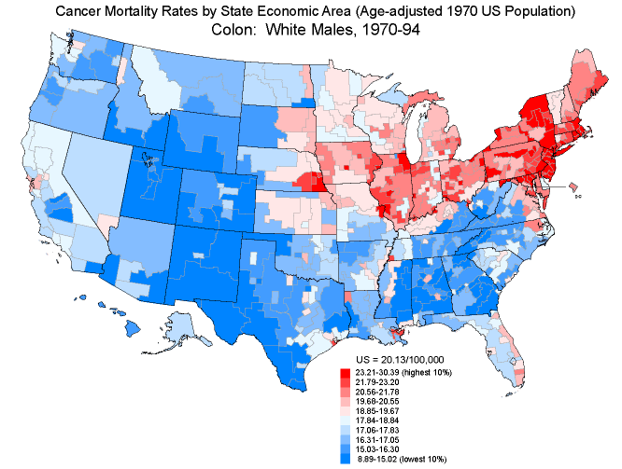
Colon Cancer Mortality Rates, White Males, 1950-69
300
300
350
350
300
350
300
350
400
400
450
500
500
450
First proposed by Cedric and Frank Garland in 1980
Dotted lines indicate annual solar radiation doses

Slide 20
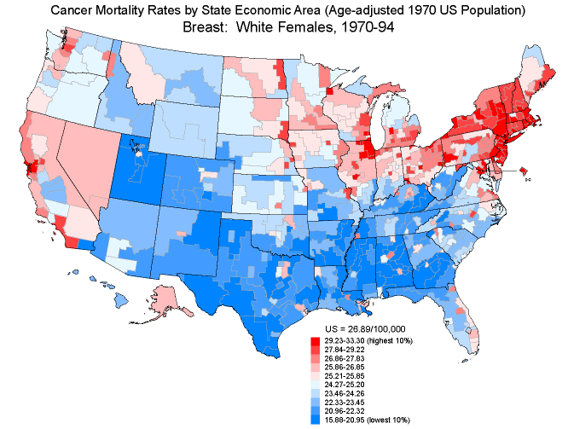
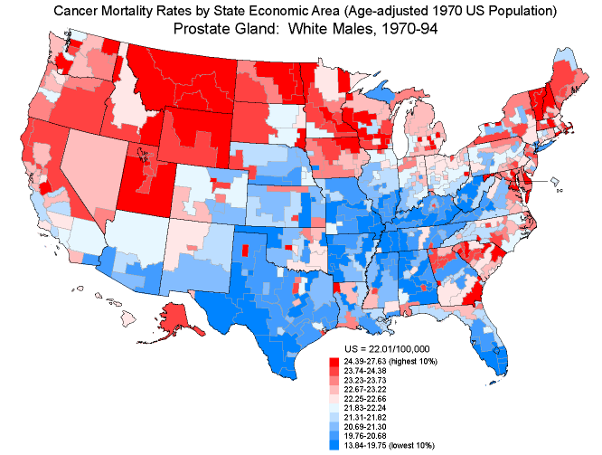
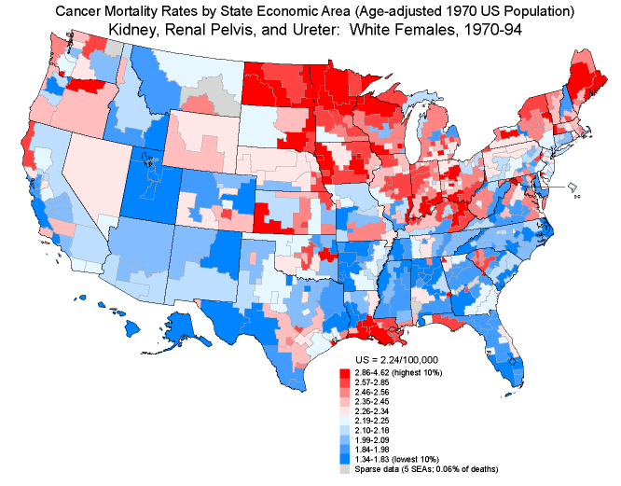
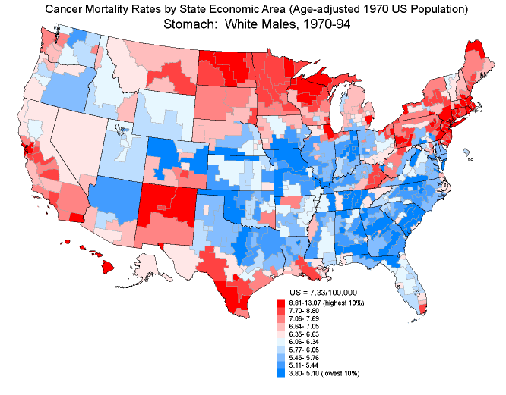
breast
prostate
stomach
kidney, urinary

Slide 21
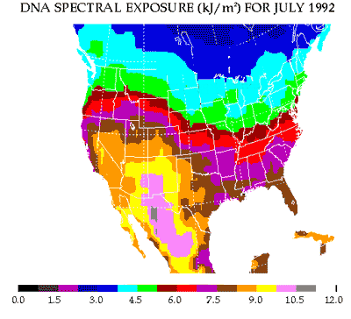

Slide 22
Types of Cancer Reduced by UVB Exposure in the U.S.
Digestive tract: Colon, esophageal, laryngeal, oral, pharyngeal, rectal, small intestine
Female: breast, endometrial, ovarian, vulvar
Urogenital: bladder, kidney, prostate, testicular
Miscellaneous organs: gallbladder, lung, pancreatic, thyroid
Blood: Hodgkin’s lymphoma, leukemia, non-Hodgkin’s lymphoma

Slide 23
Breast Cancer Incidence Odds Ratio vs. 25(OH)D Concentration
Based on 11 case-control studies
from seven countries
For ng/ml, divide by 2.5
Grant WB, Boucher BJ. PLoS One. 2017 May 1;12(5):e0176448

Slide 24
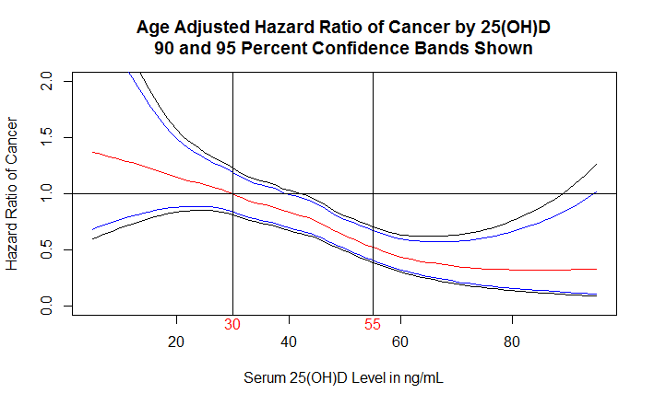
Results from the Lappe Study Based on 25(OH)D Concentrations (online only)
Lappe J, Watson P, Travers-Gustafson D, Recker R, Garland C, Gorham E, Baggerly K, McDonnell SL. JAMA. 2017 Mar 28;317(12):1234-1243.

Slide 25
Cardiovascular Disease Meta-analysis [Wang, 2012]
Divide by 2.5
For ng/ml

Slide 26
Seasonal Influenza
John Cannell proposed that influenza was largely seasonal due to seasonal variations in solar UVB doses.
Two clinical trials, one involving post-menopausal African-American women, the other involving Japanese school children (Type A only), supported that hypothesis.
(Cold temperature and low humidity also contribute to the seasonality.)

Slide 27
Pregnancy
Clinical trials in South Carolina found that pregnant women have better pregnancy and birth outcomes by taking 4000-6400 IU/d vitamin D₃ and reaching >40 ng/mL 25(OH)D.
For 25(OH)D >40 ng/mL, 1,25(OH)₂D₃ concentrations stabilize, leading to improved gene expression.

Slide 28
Benefits of Vitamin D during Pregnancy
Reduced risk of primary C-section delivery
Reduced risk of gestational diabetes.
Reduced risk of preterm birth.
For infants
Reduced risk of low-for-gestational weight.
Reduced risk of autism.
Reduced risk of asthma

Slide 29
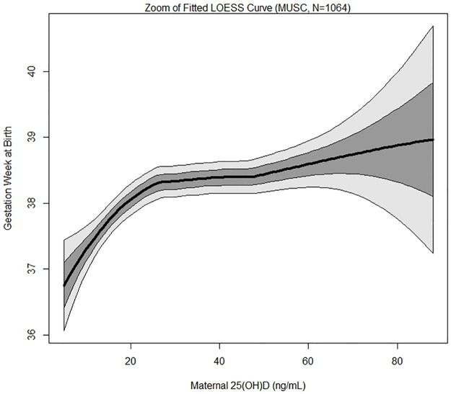
Birth Week vs. 25(OH)D Concentration
McDonnell SL, Baggerly KA, Baggerly CA, ….. Hollis BW, Wagner CL.
PLoS One. 2017 Jul 24;12(7):e0180483.

Slide 31
An estimate of the global reduction in mortality rates through doubling vitamin D levels.
The vitamin D-sensitive diseases that account for more than half of global mortality rates are CVD, cancer, respiratory infections, respiratory diseases, tuberculosis and diabetes mellitus. Additional vitamin D-sensitive diseases and conditions that account for 2 to 3% of global mortality rates.
Increasing serum 25(OH)D levels from 22 to 44 ng/ml could reduce the vitamin D-sensitive disease mortality rate by an estimated 20%, increasing life expectancy by 2 years.
Grant, Eur J Clin Nutr. 2011

Slide 32
Athletic Performance
Vitamin D may improve athletic performance in vitamin D-deficient athletes. Peak athletic performance may occur when 25(OH)D levels approach those obtained by natural, full-body, summer sun exposure, which is at least 50 ng/mL. Such 25(OH)D levels may also protect the athlete from several acute and chronic medical conditions.
Cannell et al., 2009

Slide 33
From VitaminDCouncil.org by John Cannell (2010)
The Chicago Blackhawks are the first vitamin D team in modern professional sports history.
According to my sources, the Chicago Blackhawk team physicians began diagnosing and treating vitamin D deficiency in all Blackhawk players about 18 months ago. Apparently, most players are on 5,000 IU per day.
After many losing seasons, last year the Blackhawks came out of nowhere to get to the Western conference finals. This year they are playing even better.

Slide 34
Autism Prevalence, White Children, vs. UVB dose for October
Grant and Cannell, Dermato-Endocrinolgy, 2013

Slide 35
ADHD Prevalence 2007 From the CDC

Slide 36
Dental Caries Rate for Servicemen, 1918-1934 vs. UVB Dose
Grant, Dermato-Endocrinology, 2011

Slide 37
Dental Caries – Vitamin D Clinical Trials Hujoel, 2012

Slide 38
Sleep
Raising 25OHD to 60-70 ng/ml improves sleep.
However, after two years, systemic pain develops – due to depletion of some of the gut biome involved in B vitamin production.
Solution: at that point, supplement with B100 for a couple of months.
Gominak, Med Hypothesis. 2016

Slide 39
Vitamin D and Verbal Fluency
Performance on verbal fluency, differed by vitamin D status. Specifically, participants with supratherapeutic levels provided a greater number of words than those with insufficient
Similarly, vitamin D status was a significant independent predictor of verbal. Spline analyses revealed that there is a positive, near-linear association between verbal fluency and 25(OH)D levels up to and exceeding 40 ng/ml.
Pettersen, JCEN, 2016

Slide 40
Vitamin D Status and Rates of Cognitive Decline in a Multiethnic Cohort of Older Adults
Rates of decline in episodic memory and executive function among VitD-deficient participants were greater than those with adequate status after controlling for age, sex, education, ethnicity, body mass index, season of blood draw, vascular risk, and apolipoprotein E4 genotype.
Miller et al., JAMA Neurol, 2015

Slide 41
Alzheimer’s and Dementia Prospective Study 5.6 yrs
Littlejohns et al., Neurology, 2014
Divide by 2.5 for ng/ml

Slide 42
Erectile Dysfunction
Farag et al., 2016

Slide 43
Testosterone - 1
Participants received either 83 μg (3,332 IU) vitamin D daily for 1 year (n = 31) or placebo (n =2 3). Initial 25(OH)D concentrations were in the deficiency range (< 20 ng/ml) and testosterone values were at the lower end of the reference range (9.1-55.3 nmol/l for males aged 20-49 years) in both groups. Mean circulating 25(OH)D concentrations increased significantly by 21 ng/ml in the vitamin D group, but remained almost constant in the placebo group.

Slide 44
Testosterone - 2
Compared to baseline values, a significant increase in total testosterone levels (from 10.7 ± 3.9 nmol/l to 13.4 ± 4.7 nmol/l; p < 0.001), bioactive testosterone (from 5.2 ± 1.9 nmol/l to 6.3 ± 2.0 nmol/l; p = 0.001), and free testosterone levels (from 0.22 ± 0.08 nmol/l to 0.27 ± 0.09 nmol/l; p = 0.001) were observed in the vitamin D supplemented group.
Pilz et al., 2011

Slide 45
Surgery
The mean length of stay in the Surgical Intensive Care Unit for the severe vitamin D-deficient group was 13 ± 20 days versus 7 ± 15 days and 5 ± 7 days for the moderate and mild vitamin D-deficient groups, respectively, which was clinically significant (P = 0.002).
Matthews et al., Am J Surg, 2012

Slide 46
Where is Vitamin D Policy Headed?
The IOM recommendation of 2010 is now considered incorrect.
Several major vitamin D supplementation trials will complete data collection soon.
They generally used 2000 IU/d or 100,000 IU/mo vitamin D₃, perhaps with calcium.
The results of these studies will provide much of the basis for next recommendations.

Slide 48
Why Vitamin D Clinical Trials Should Be Based on 25(OH)D Concentrations
Most trials used principles designed to test pharmaceutical drugs:
the trial is the sole source of the agent, and
dose-response relationships are linear.
However, neither assumption is true for vitamin D since neither vitamin D dose-responses or health outcome-serum 25(OH)D concentration relationships are linear.

Slide 49
Variation of 25(OH)D Concentration with Oral Vitamin D Intake
Garland CF, French CB, Baggerly LL, Heaney RP.
Anticancer Res. 2011 Feb;31(2):607-11.

Slide 50
Necessity for Vitamin D Clinical Trials
Observational studies could be using 25(OH)D concentration as an index of diet [e.g., meat eaters get 25(OH)D from meat] or UVB exposure.
Findings of mechanisms does not tell how important vitamin D is in reducing risk.
Health systems look to clinical trials as the “gold standard”.

Slide 52
Why vitamin D clinical trials should be based on 25(OH)D concentrations - 2
We propose a hybrid observational approach to vitamin D RCT design, based primarily on serum 25(OH)D concentration, requiring an understanding of serum 25(OH)D concentration-health outcome relationships, measuring baseline 25(OH)D values, recruiting non-replete subjects, measuring serum 25(OH)D during the trial for adjustment of supplemental doses for achievement of pretrial selection of target 25(OH)D values, where possible, and analyzing health outcomes in relation to those data rather than solely to vitamin D dosages.
Grant et al., JSBMB, 2017

Slide 53
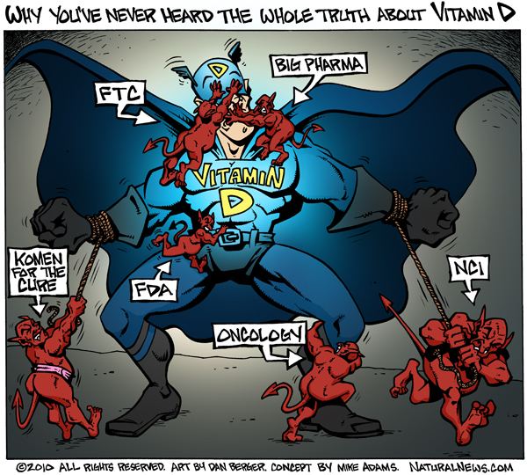
http://www.naturalnews.com/028353_vitamin_D_sunlight.html

Slide 55
For More Information
www.ncbi.nlm.nih.gov/pubmed/
scholar.google.com/
grassrootshealth.net/
www.vitamindwiki.com/VitaminDWiki
www.vitamindcouncil.org
vitamindsociety.org/

